Slide 1

Backpacking Merit Badge
Troop 344 and 9344
Pemberville, OH

Slide 2
Backpacking Merit Badge Requirements
Discuss the prevention of and treatment for the health concerns that could occur while backpacking, including hypothermia, heat reactions, frostbite, dehydration, insect stings, tick bites, snakebite, and blisters.
Do the following:
  List 10 items that are essential to be carried on any backpacking trek and explain why each item is necessary.
  Describe 10 ways you can limit the weight and bulk to be carried in your pack without jeopardizing your health or safety.
Do the following:
  Define limits on the number of backpackers appropriate for a trek crew.
  Describe how a trek crew should be organized.
  Tell how you would minimize risk on a backpacking trek.
  Explain the purpose of an emergency response plan.

Slide 3
Backpacking Merit Badge Requirements
Do the following:
  Describe the importance of using Leave No Trace principles while backpacking, and at least five ways you can lessen the crew’s impact on the environment.
  Describe proper methods of handling human and other wastes while on a backpacking trek. Describe the importance of and means to assure personal cleanliness while on a backpacking trek.
  Tell what factors are important in choosing a campsite.
Do the following:
  Demonstrate two ways to treat water and tell why water treatment is essential.
  Explain to your counselor the importance of staying well hydrated during a trek.

Slide 4
Backpacking Merit Badge Requirements
Do the following:
  Demonstrate that you can read topographic maps.
  While on a trek, use a map and compass to establish your position on the ground at three different locations, OR use a GPS receiver to establish your position on a topographic map and on the ground at three different locations.
  Explain how to stay found, and what to do if you get lost.
Tell how to prepare properly for and deal with inclement weather.
Do the following:
  Explain the advantages and disadvantages of the different types of backpacking stoves using at least three different types of fuel.
  Demonstrate that you know how to operate a backpacking stove safely and to handle liquid fuel safely.
  Prepare at least three meals using a stove and fuel you can carry in a backpack.
  Demonstrate that you know how to keep cooking and eating gear clean and sanitary , and that you practice proper methods for food storage while on a backpacking trek.

Slide 5
Backpacking Merit Badge Requirements
Do the following:
  Write a plan that includes a schedule for a patrol/crew backpacking hike of at least 2 miles.
  Conduct a prehike inspection of the patrol and its equipment.
  Show that you know how to properly pack your personal gear and your share of the crew’s gear and food.
  Show you can properly shoulder your pack and adjust it for proper wear.
  While using the plan you developed for requirement 9a, carry your fully loaded pack to complete a hike of at least 2 miles.
Using Leave No Trace principles, participate in at least three backpacking treks of at least three days each and at least 15 miles each, and using at least two different campsites on each trek. Carry everything you will need throughout the trek.

Slide 6
Backpacking Merit Badge Requirements
Do the following:
  Write a plan for a backpacking trek of at least five days using at least three different campsites and covering at least 30 miles. Your plan must include a description of and route to the trek area, a schedule (including a daily schedule), a list of food and equipment needs, a safety and emergency plan, and a budget.
  Using Leave No Trace principles, take the trek as planned in requirement 11a that is at least five full days, covering at least 30 miles and utilizing at least three different campsites. While on trek, complete at least one service project approved by your merit badge counselor.
  Keep a daily journal during the trek that includes a day-by-day description of your activities, including notes about what worked well and thoughts about improvements that could be made for the next trek.

Slide 7
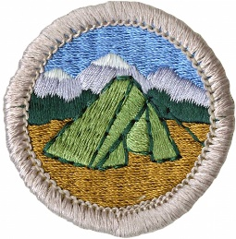
Although not required, it is strongly suggested that you earn the Camping Merit Badge prior to earning the Backpacking Merit Badge. Many of the important skills necessary for a successful backpacking trek are required as part of the Camping Merit Badge but are not included in the Backpacking Merit Badge requirements.

Slide 8
Requirement 1
Discuss the prevention of and treatment for the health concerns that could occur while backpacking, including hypothermia, heat reactions, frostbite, dehydration, insect stings, tick bites, snakebite, and blisters.

Slide 9
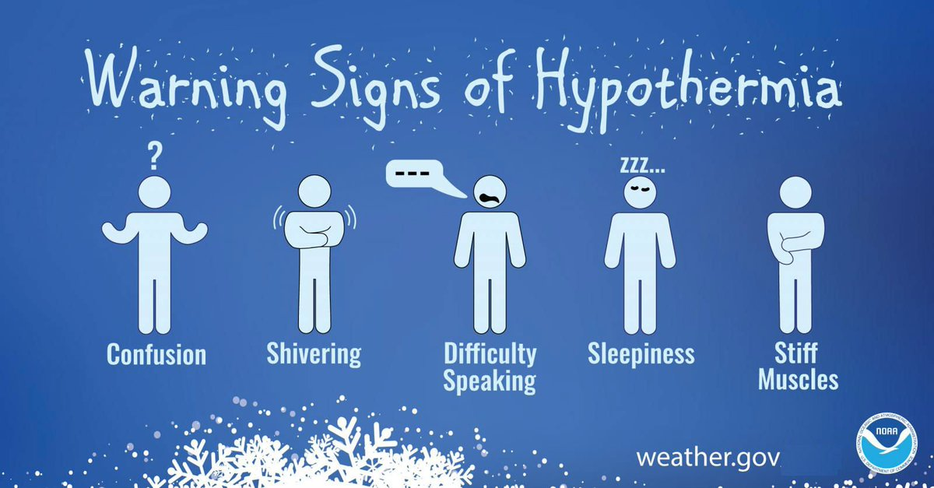
1. Hypothermia
Occurs when body cannot make heat as fast as it loses it.
Internal body temperature drops below 95ºF.
Can occur whenever and wherever a person feels cold, including indoors in poorly heated areas.

Slide 10
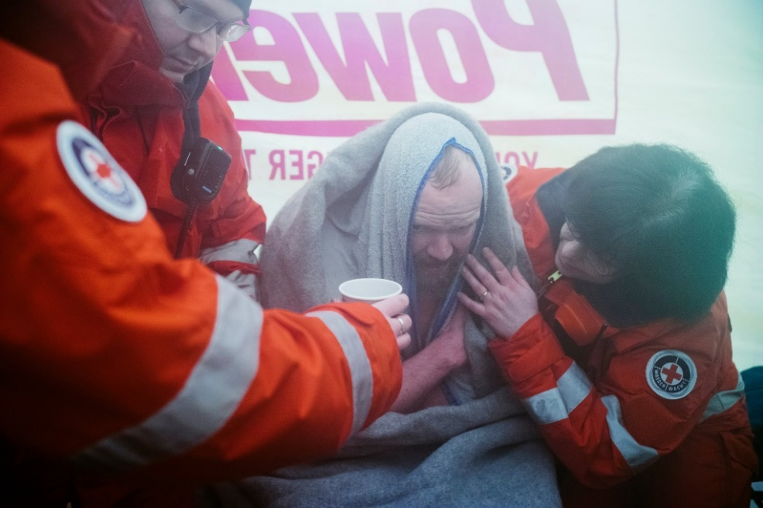
1. Hypothermia
Move victim to shelter.
Remove wet clothing and wrap victim in warm covers.
Apply direct body heat.
Re-warm neck, chest, abdomen, and groin first.
Give warm, sweet drinks if conscious.
Monitor breathing, administer CPR.
Get medical help.

Slide 11
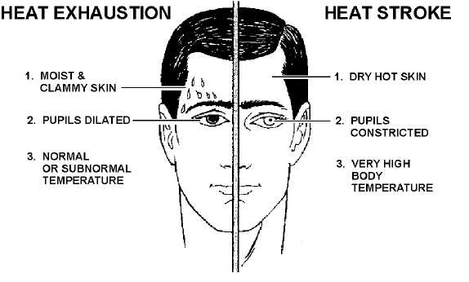
1. Heat Reactions

Slide 12
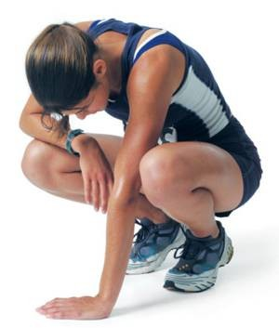
1. Heat Exhaustion Symptoms
Heavy sweating
Thirst
Fatigue
Heat cramps
Headache
Dizziness
Nausea
Vomiting

Slide 13
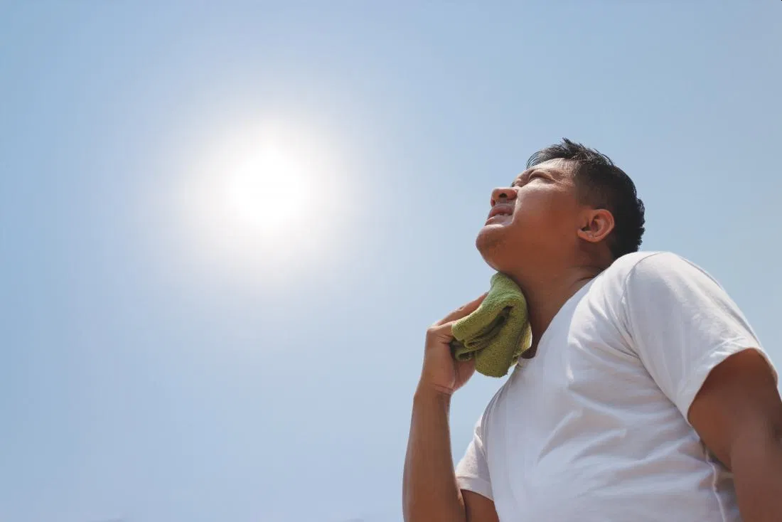
1. First Aid for Heat Exhaustion
Move victim from heat to rest in a cool place.
Loosen or remove unnecessary clothing.
Give water or a sports drink.
Raise feet 8-12 inches.
Put cool, wet cloths on forehead and body – spray skin with water.
Seek medical care if victim’s condition worsens or does not improve within 30 minutes.

Slide 14
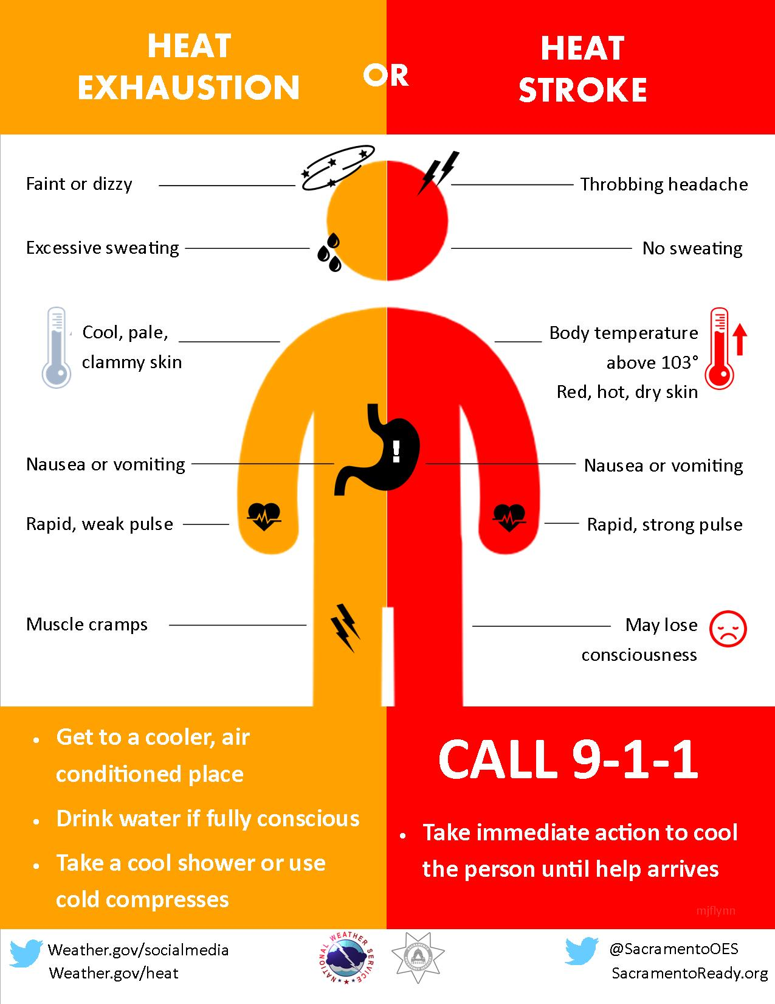
Heatstroke

Slide 15
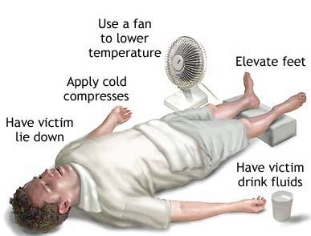
1. First Aid for Heat Stroke
Call 911.
Move victim to cool place.
Remove outer clothing.
Cool victim quickly.
Apply cold compresses or spray skin with water.
Put ice bags or cold packs beside neck, armpits, and groin.

Slide 16
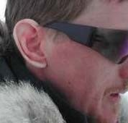
1. Frost Nip
Frost nip is an earlier and milder case of frostbite. Usually the ears, cheeks, nose, fingers and toes are affected.
Skin white or numb.
Don’t rub – hold against a warm body part.
Change clothing and/or environment.
Frost nip is a warning that you are not keeping warm enough!

Slide 17
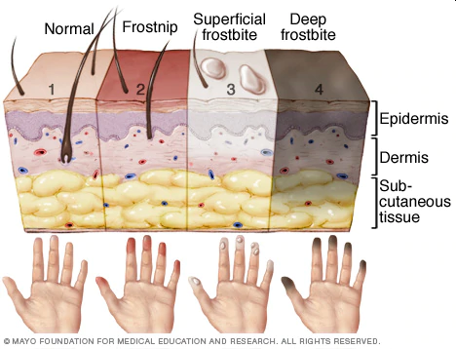
1. Frostbite
Mild Frostbite:
  Skin looks waxy and white, gray, yellow, or bluish.
  Area is numb or feels tingly or aching
Severe Frostbite:
  Area feels hard.
  May become painless
  After warming, area becomes swollen and may blister.

Slide 18
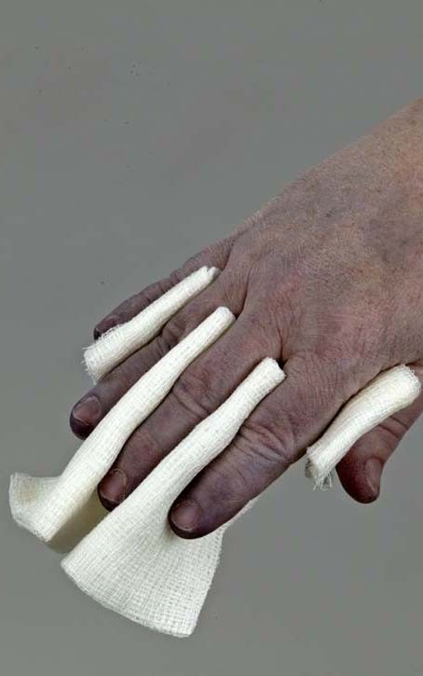
1. First Aid for Frostbite
Move victim to warm environment.
Hold frostbitten area in hands to warm – do not rub.
Remove any tight clothing or jewelry around area.
Put dry gauze or fluffy cloth between frostbitten fingers or toes.
Do not use heat lamp, campfire, or heating pad to rewarm.
Seek medical attention immediately.

Slide 19
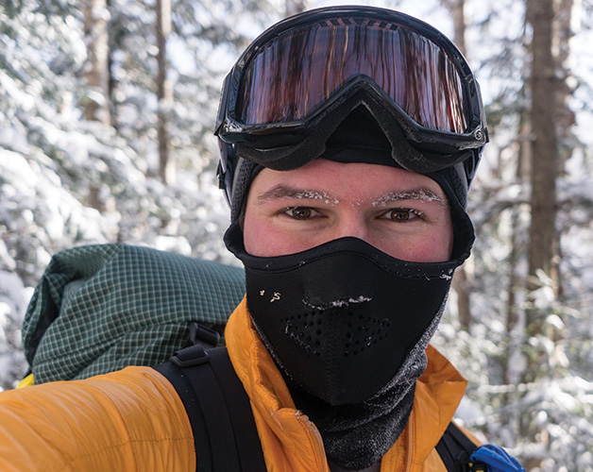
1. Prevention of Frostbite
Be sure you dress in layers for cold weather. The first layer should be thermal underwear, and the outer layer needs to be waterproof. The layers should be loose, not tight. Mittens are warmer than gloves.
You should wear a hat. Over 50% of a your body heat is lost from the head.
Set limits on the time spent outdoors when the wind-chill temperature falls below 0°F (-18°C).
Recognize the earliest warnings of frostbite. Tingling and numbness are reminders that your are not dressed warmly enough for the weather and needs to go indoors.

Slide 20

1. Dehydration
When the body puts out more liquid than it is taking in.
Ways we lose fluids:
  Sweating.
  Urination.
  Vomiting.
Signs of dehydration:
  Thirst.
  Yellow or dark urine.
  Dry mouth.
  Lightheadedness.
  Nausea and vomiting.
  Dry skin.
  Cease sweating.
Treatment:
  Drink fluids (water, Gatorade).
  Avoid physical activity.
  Get inside air conditioned or cool area.

Slide 21
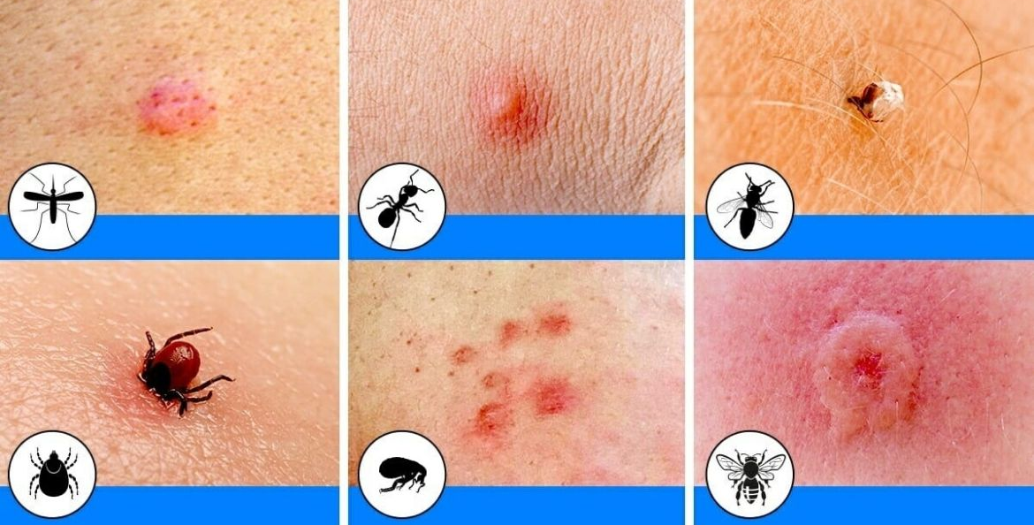
1. Insect Bites
Bites of mosquitoes and chiggers (harvest mites usually cause itchy, red bumps. The size of the swelling can vary from a dot to a half inch.
Signs that a bite is from a mosquito are: itchiness, a central raised dot in the swelling, a bite on skin not covered by clothing, and summertime,
Bites from horseflies, deerflies, gnats, fire ants, harvester ants, blister beetles, and centipedes usually cause a painful, red bump.
Fire ant bites change to blisters or pimples within a few hours.

Slide 22

1. Treatment of Insect Bites
Apply calamine lotion or a baking soda paste to the area of the bite.
If the itch is severe (as with chiggers), apply nonprescription 1% hydrocortisone cream four times a day.
Do not to pick at the bites or they can become infected or leave scars.
Cold, moist compresses or ice on the area can help.

Slide 23
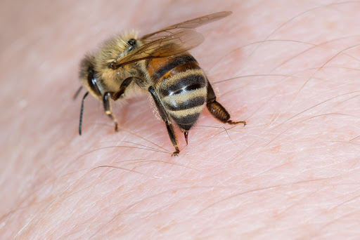
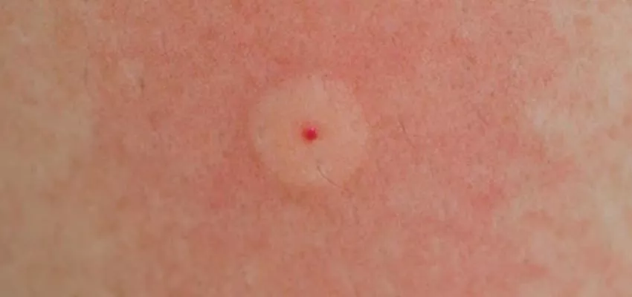
1. Bee Stings
Honey bees, bumble bees, hornets, wasps, and yellow jackets can all sting.
These stings cause immediate painful red bumps.
While the pain is usually better in 2 hours, the swelling may increase for up to 24 hours.

Slide 24
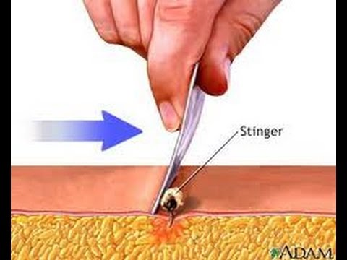
1.Treatment of Bee Stings
If you see a little black dot in the bite, the stinger is still present (this only occurs with honey bee stings).
Remove it by scraping it off with a credit card or something similar.
For persistent pain, massage with an ice cube for 10 minutes.
Give acetaminophen immediately for relief of pain and burning.
For itching, apply hydrocortisone cream.

Slide 25
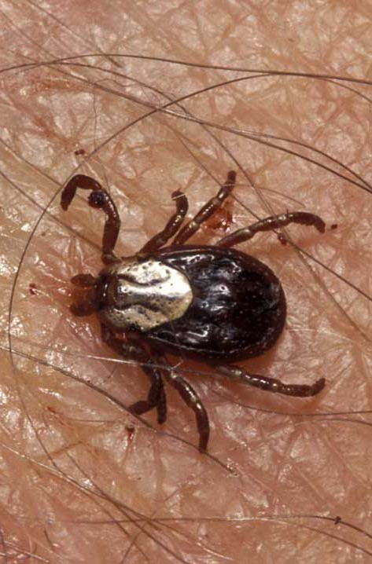
1. Tick Bites
Can transmit Rocky Mountain spotted fever or Lyme disease.
Tick embeds its mouth parts in skin and may remain for days sucking blood.

Slide 26
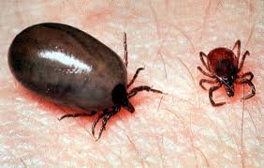
1. Engorged Tick

Slide 27
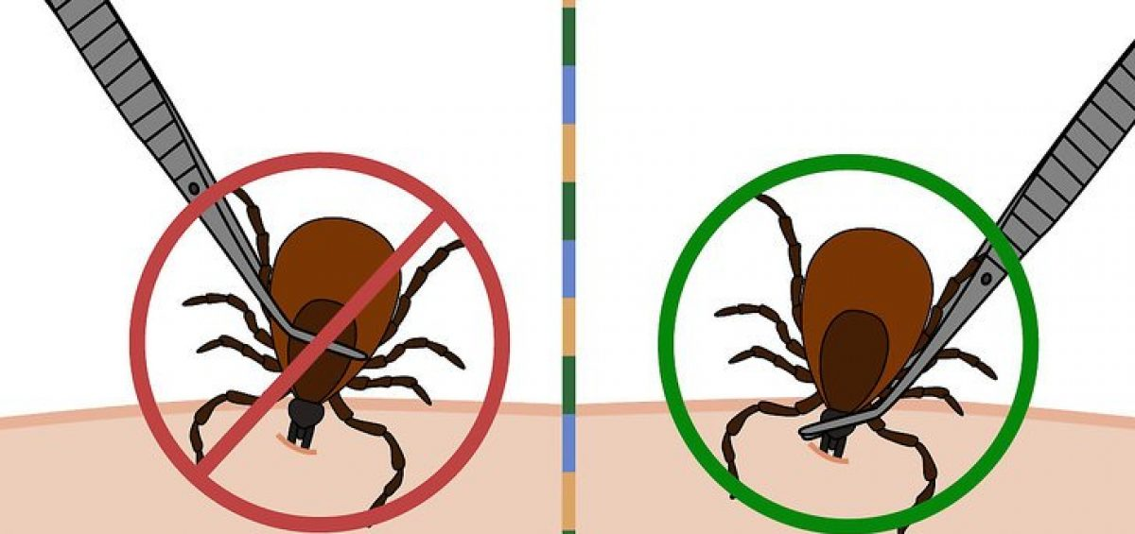
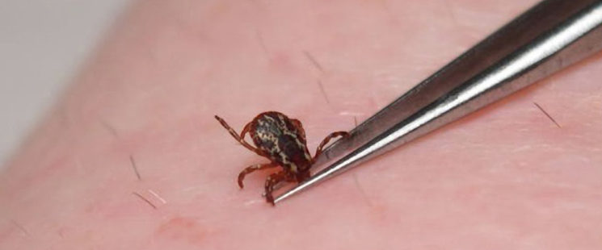
1. Tick Removal
Grasp the tick’s mouthparts against the skin, using pointed tweezers.
Pull steadily without twisting until you can ease the tick head straight out of the skin.
DO NOT squeeze or crush the body of the tick.
DO NOT apply substances such as petroleum jelly, nail polish, or a lighted match to the tick while it is attached.

Slide 28
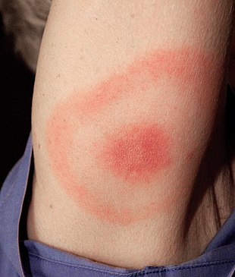
1. Tick Removal (cont.)
Once you have removed the tick, wash the wound site and your hands with soap and water, and apply rubbing alcohol or antiseptic to the site.
Observe the bite over the next two weeks for any signs of an expanding red rash or flu-like symptoms (Lyme Disease).
Lyme Disease Rash

Slide 29
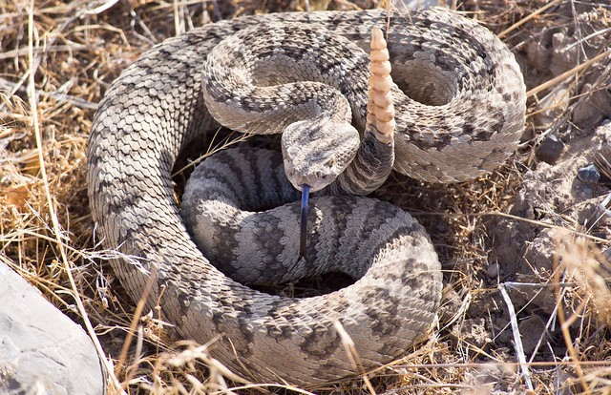
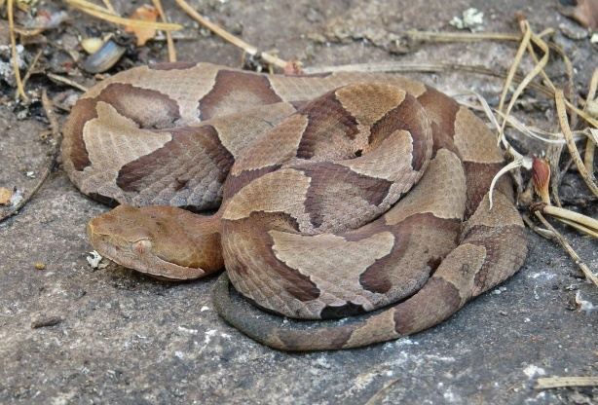
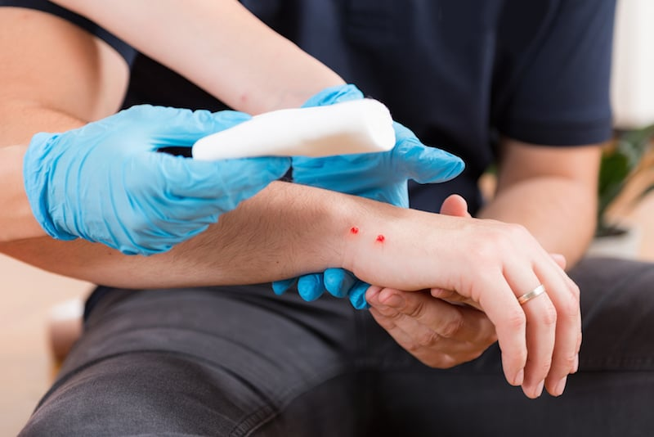
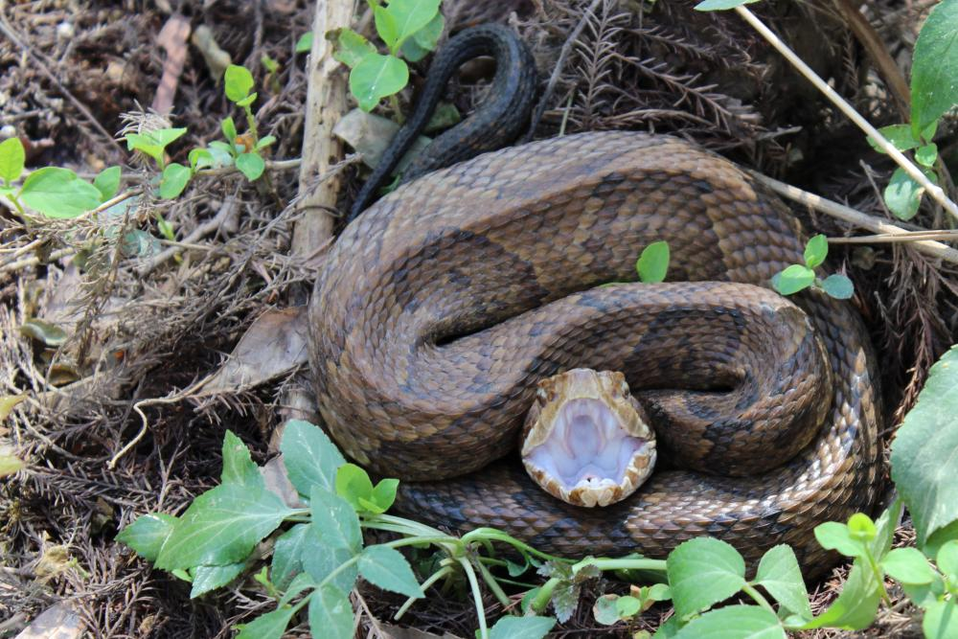
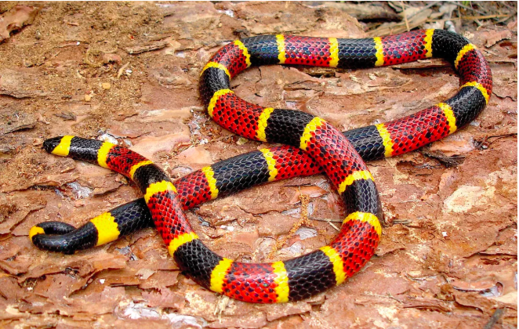
1. Poisonous Snakebite
In the U.S. the poisonous snakes are rattlesnakes, copperheads, cottonmouths, and coral snakes.
Currently about 8,000 people per year in the U.S. are bitten by a poisonous snake, of which about 6 will die.

Slide 30
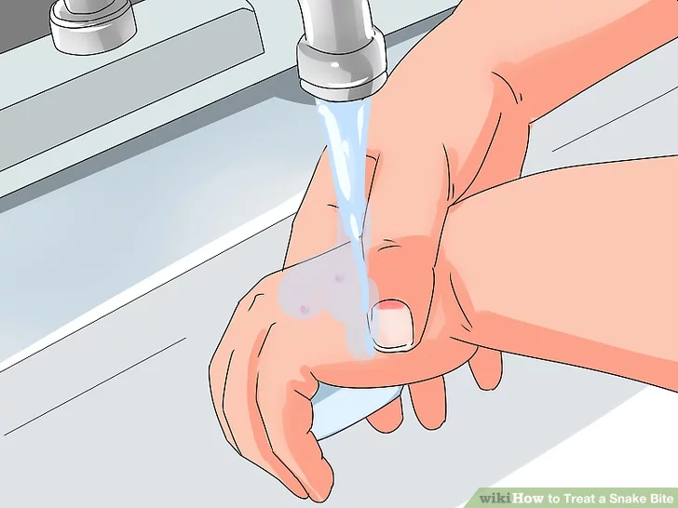
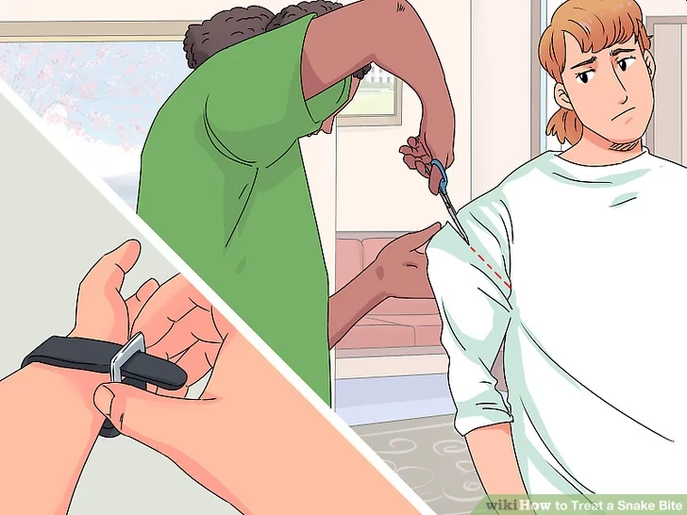
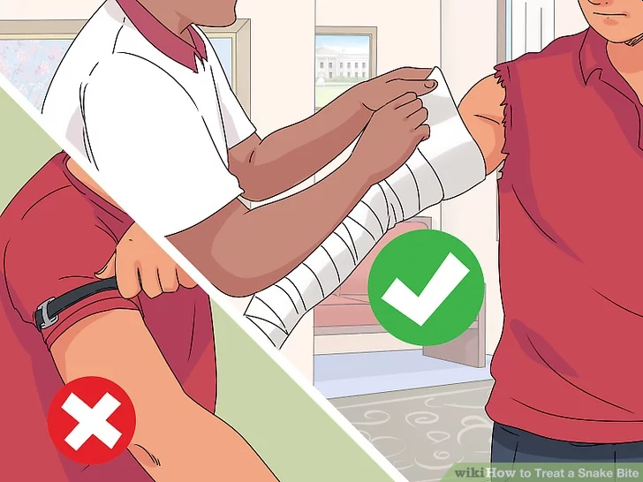
1. First Aid for Poisonous Snake Bites
Have victim lie down and stay calm.
Keep bitten area immobile and below level of heart.
Call 911.
Wash bite wound with soap and water.
Remove jewelry or tight clothing before swelling.
Do not try to catch snake but note appearance.
If possible, wrap entire extremity with elastic (compression) bandage to slow spread of venom.
Do not use a tourniquet.
Do not cut wound open to try to drain or suck venom out.

Slide 31
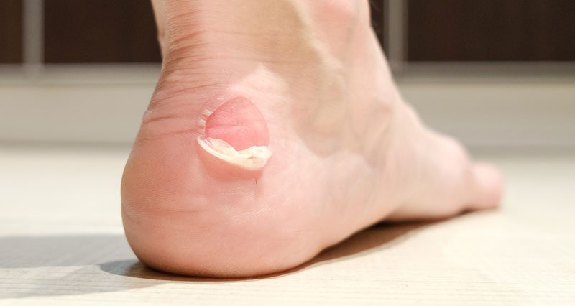
1. Blisters
A blister is skin injury that is usually filled with water.
Blisters commonly occur on the feet or hands.
They are most often caused by the hands or feet rubbing against something (such as wearing new shoes).

Slide 32
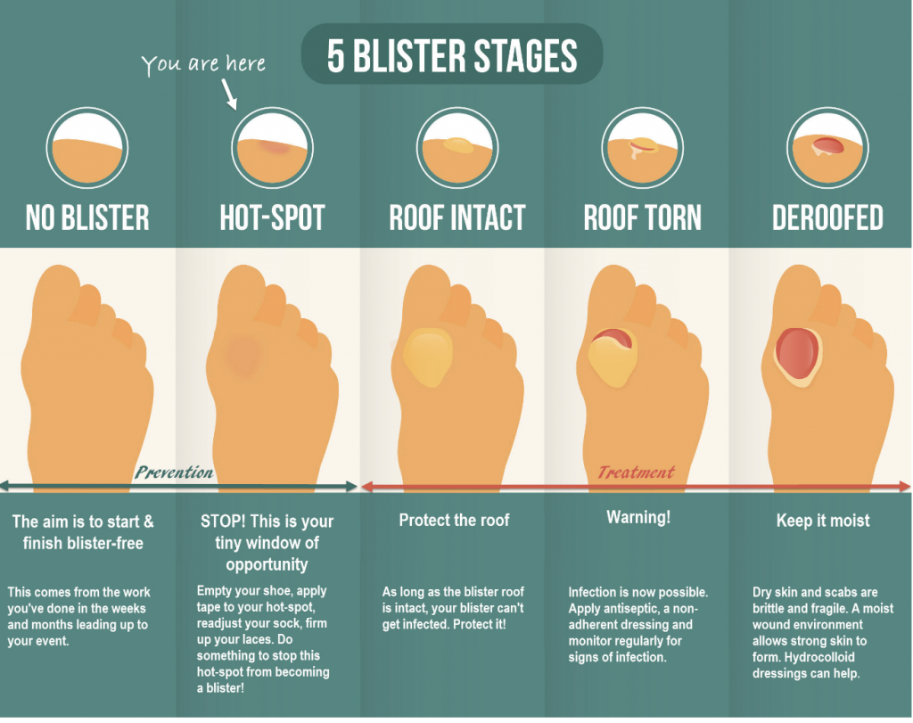

Slide 33
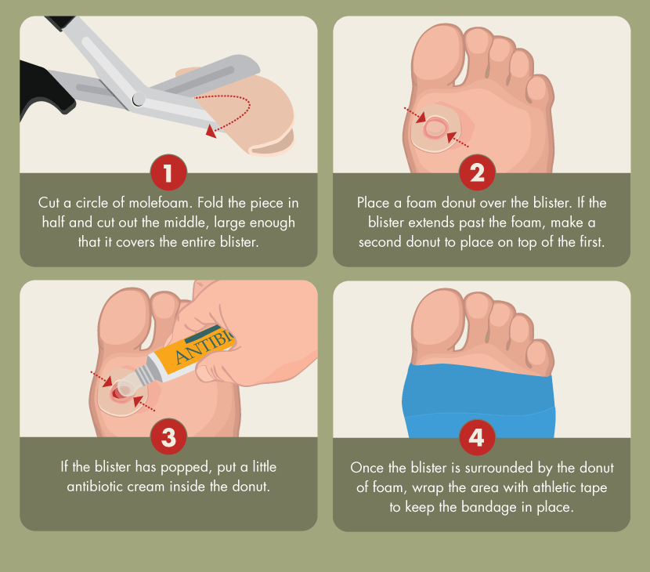
1. Treatment for Blisters
Do not open the blisters, since this increases the possibility of infection.
Clean the skin around it.
Take the pressure off the area by placing a Band-Aid over the blister or Moleskin with a hole cut in the center.
If the blister accidentally breaks open, trim off the loose skin.
Keep the surface clean by washing it twice a day with an antibacterial soap (such as Dial or Safeguard).
Apply an antibiotic ointment and a Band-Aid to help with healing.

Slide 34
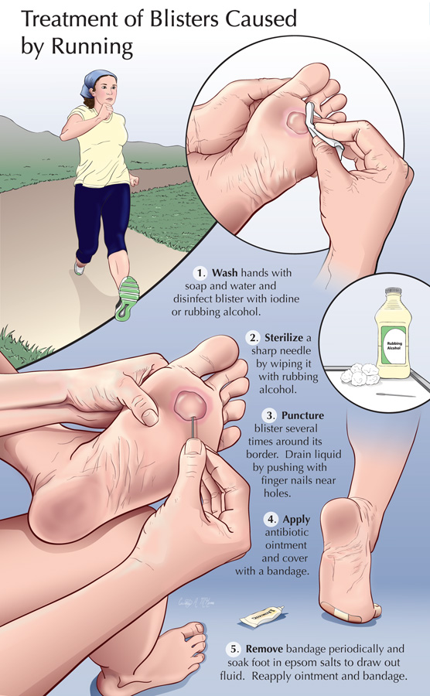
1. Popping a Blister
If a blister is in a frequently used area that has a high risk of rupturing, it may be best to pop it to make sure it’s properly protected against infection.
Wash your hands and the blister thoroughly.
Disinfect a needle with alcohol.
Carefully puncture the blister.
  Poke three or four shallow holes around the edge of the blister.
  You want to keep as much of the skin intact as possible.
  Allow the fluid to drain out.
Cover the blister with a first aid ointment such as Neosporin.
Apply a dressing.
  Cover the blister tightly with a bandage or gauze.
Repeat if necessary.
  You may need to perform these steps every six to eight hours for the first 24 hours.
  After that, change the dressing and apply ointment daily.

Slide 35
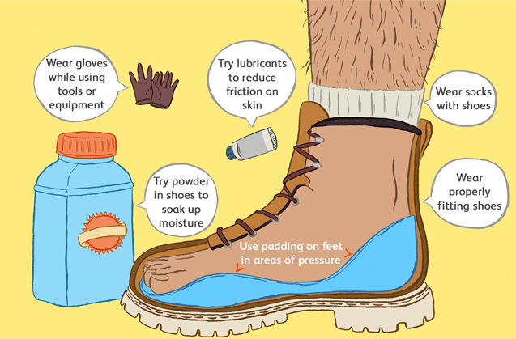
1. Preventing Blisters
Friction can also be reduced by wearing two pairs of socks.
Place Moleskin on sensitive areas were the friction may occur.

Slide 36
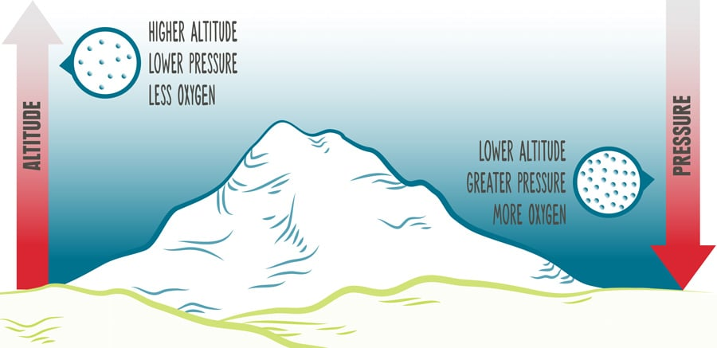
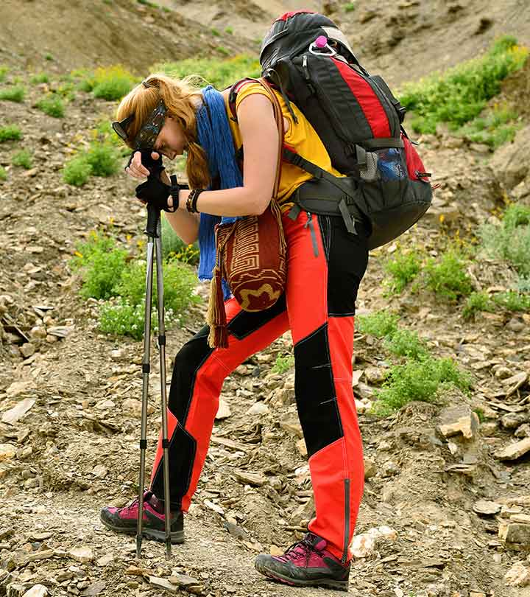
1. Altitude Sickness
Camping may take you to high places where altitude sickness (also known as AMS, or Acute Mountain Sickness) can be a concern.
Altitude sickness is seldom a problem for people at elevations of less than 8,000 feet above sea level.
High altitudes may leave you short of breath due to less oxygen.
Your body will acclimate to higher altitudes within a few days by producing extra red blood cells to carry more oxygen.
To help prevent altitude sickness:
  Drink plenty of fluids.
  Ascend gradually and permit your body to acclimate as you go higher (increase your altitude by no more than 1,000 feet/day).

Slide 37
Requirement 2
Do the following:
  List 10 items that are essential to be carried on any backpacking trek and explain why each item is necessary.
  Describe 10 ways you can limit the weight and bulk to be carried in your pack without jeopardizing your health or safety.

Slide 38
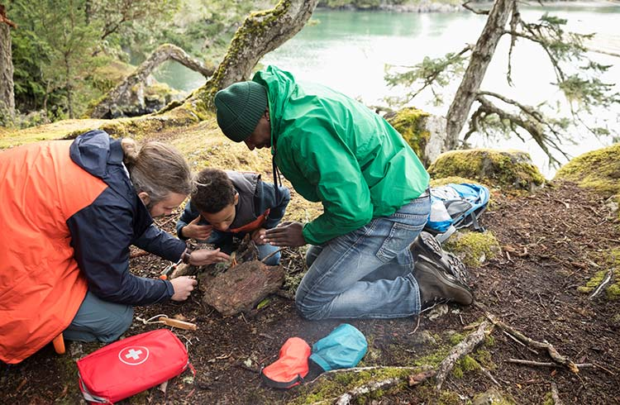
2a. Ten Essentials
Packing the “Ten Essentials” whenever you step into the backcountry, even on day hikes, is a good habit.
On a routine trip you may use only a few of them or none at all.
It’s when something goes awry that you’ll truly appreciate the value of carrying these items that could be essential to your survival.

Slide 39
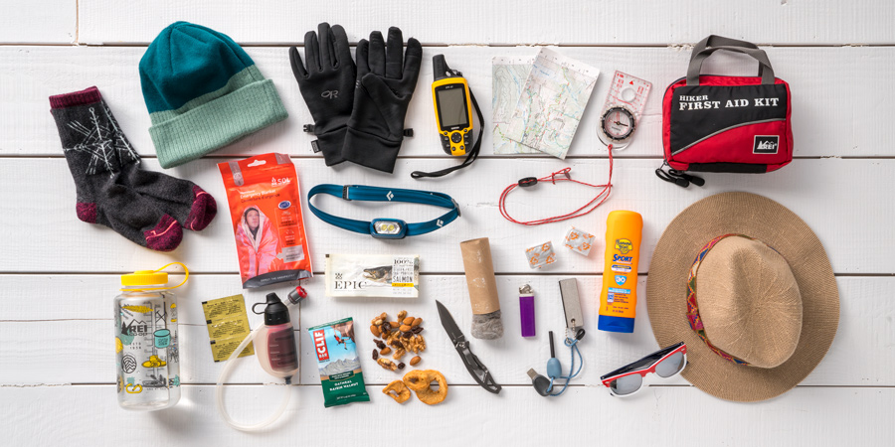
2a. Ten Essentials
Navigation: map, compass, altimeter, GPS device, personal locator beacon (PLB) or satellite messenger
Headlamp: plus extra batteries
Sun protection: sunglasses, sun-protective clothes and sunscreen
First aid: including foot care and insect repellent (as needed)
Knife: plus a gear repair kit
Fire: matches, lighter, tinder and/or stove
Shelter: carried at all times (can be a light emergency bivy)
Extra food: Beyond the minimum expectation
Extra water: Beyond the minimum expectation
Extra clothes: Beyond the minimum expectation

Slide 40
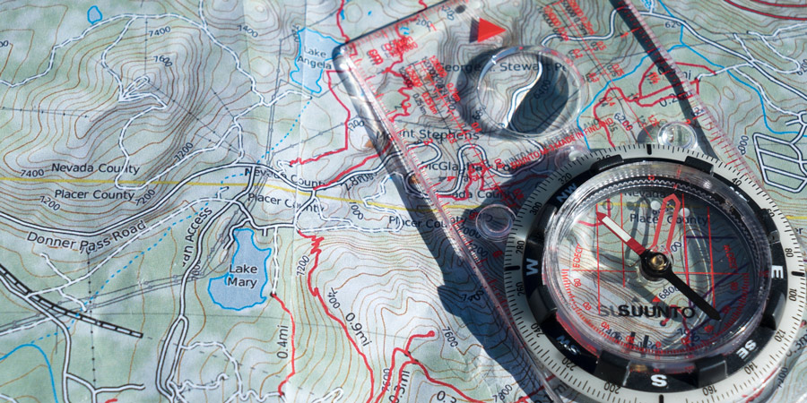
2a. Ten Essentials
Navigation
Map: A topographic map should accompany you on any trip that involves anything more than a short, impossible-to-miss footpath or frequently visited nature trail.
Compass: A compass, combined with map-reading knowledge, is a vital tool if you become disoriented in the backcountry.
GPS device: A GPS device allows you to accurately find your location on a digital map.
Personal locator beacon (PLB) or satellite messenger: These gadgets can be used to alert emergency personnel if you need help in the backcountry.

Slide 41
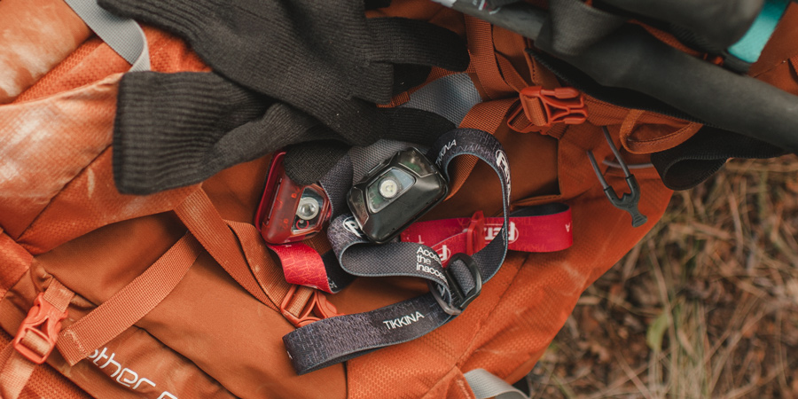
2a. Ten Essentials
Headlamp
Being able to find your way through the wilderness at night is essential, so you always need to have a light source with you.
A headlamp is the preferred choice of most backcountry travelers because it keeps your hands free for all types of tasks, whether that’s cooking dinner or holding trekking poles.
Always carry extra batteries.

Slide 42
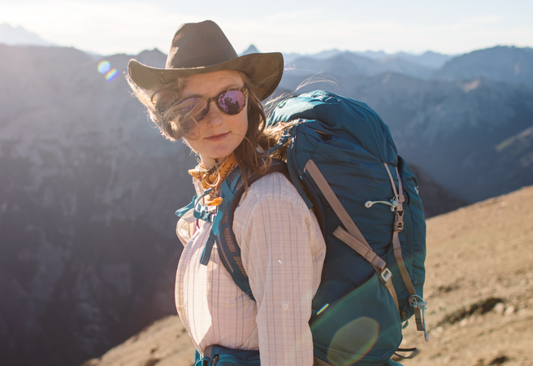
2a. Ten Essentials
Sun Protection
Sunglasses: Quality sunglasses are indispensable in the outdoors to protect your eyes from potentially damaging radiation.
Sunscreen: Spending long hours outdoors can expose you to ultraviolet rays, the cause of sunburn, premature skin aging and skin cancer.
  When selecting a sunscreen, health experts advise choosing a formula that offers a sun protection factor (SPF) of at least 15.
  Apply the sunscreen generously and thoroughly to all exposed skin.
  Depending on many factors (time of day, sweat and more), you should reapply as often as every two hours.
  Don’t overlook SPF-rated lip balm.
Sun-protection clothing: Clothing can be an effective way of blocking UV rays from reaching your skin without having to slather on sunscreen.

Slide 43
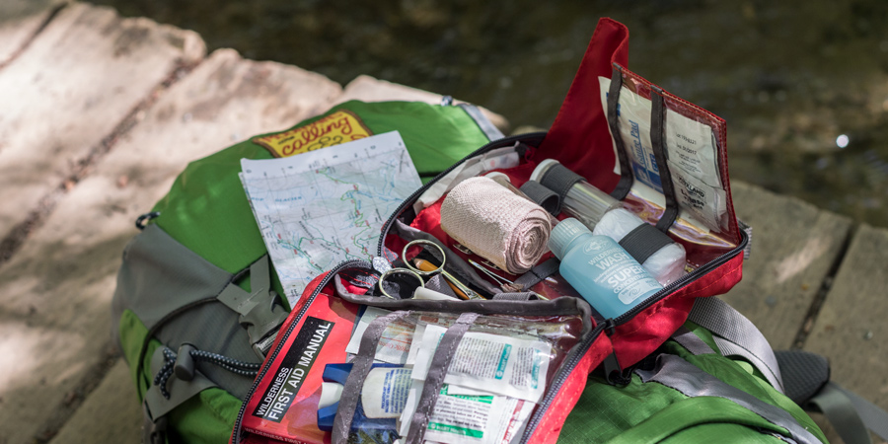
2a. Ten Essentials
First Aid
It’s vital to carry and know how to use the items in a first-aid kit.
Pre-assembled first-aid kits take the guesswork out of building your own, though many people personalize these kits to suit individual needs.
Any kit should include treatments for blisters, adhesive bandages of various sizes, several gauze pads, adhesive tape, disinfecting ointment, over-the-counter pain medication, nitrile gloves, pen and paper.
The length of your trip and the number of people involved will impact the contents of your kit.
It's also a good idea to carry some sort of compact guide to dealing with medical emergencies.

Slide 44
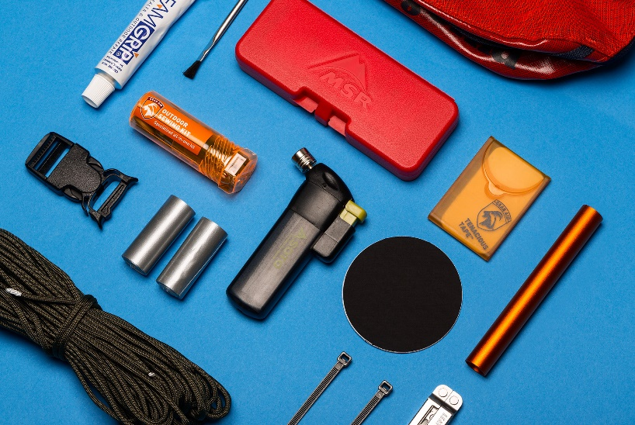
2a. Ten Essentials
Knife
Knives are handy for gear repair, food preparation, first aid, making kindling or other emergency needs, making them an essential for every outing.
A basic knife may have only a single foldout blade; more elaborate knives and multitools include things like one or two flathead screwdrivers, a can opener and/or a pair of foldout scissors.
In addition, a small gear repair kit can get you out of a bind in the backcountry (and the more remote you are, the more important your kit becomes).
  Common items include duct tape, cordage, fabric repair tape, zip ties, safety pins and repair parts for a water filter, tent poles, stove, and sleeping pad.

Slide 45
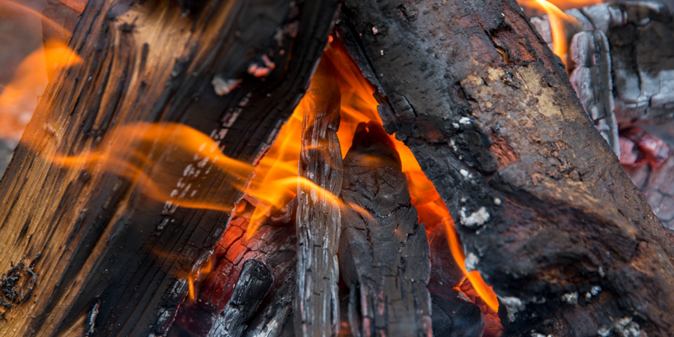
2a. Ten Essentials
Fire
In case of an emergency, you need to have reliable supplies with you for starting and maintaining a fire. For many people, this is a disposable butane lighter, but matches are also suitable so long as they are waterproof or stored in a waterproof container.
A firestarter is an element that helps you jump-start a fire and is indispensable in wet conditions.
  The ideal firestarter ignites quickly and sustains heat for more than a few seconds.
For outings where firewood is not available, such as trips above tree line and/or on snow, a stove is recommended as an emergency heat and water source.

Slide 46
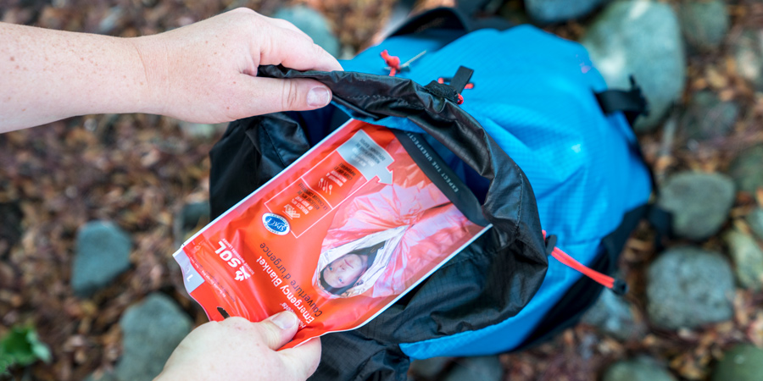
2a. Ten Essentials
Emergency Shelter
Always carry some type of emergency shelter to protect you from wind and rain in case you get stranded or injured on the trail.
Options include an ultralight tarp, a bivy sack, an emergency space blanket (which packs small and weighs just ounces) or even a large plastic trash bag.
It’s important to understand that your tent is only your emergency shelter if you have it with you at all times (a tent left behind at your camp is not sufficient).

Slide 47
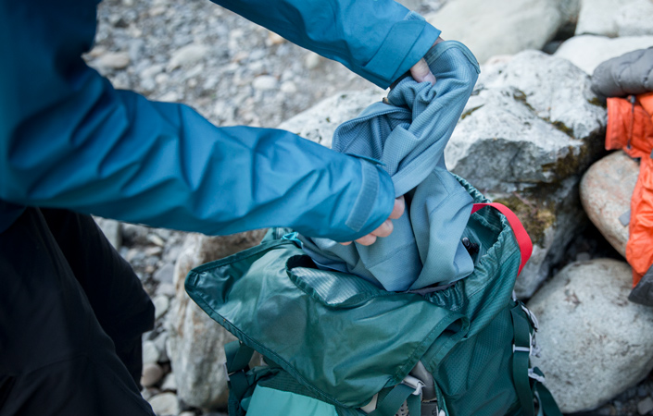
2a. Ten Essentials
Extra Clothes
Conditions can abruptly turn wet, windy or chilly in the backcountry, or an injury can result in an unplanned night out.
It’s necessary to carry extra clothes beyond those required for your trip.
When deciding what to bring, think about what you would need to survive a long, inactive period out in the elements.
  Common options include a layer of underwear (tops and bottoms), an insulating hat or balaclava, extra socks, extra gloves and a synthetic jacket or vest.
  For winter outings, bring insulation for your upper body and legs.

Slide 48
Requirement 2
Do the following:
  List 10 items that are essential to be carried on any backpacking trek and explain why each item is necessary.
  Describe 10 ways you can limit the weight and bulk to be carried in your pack without jeopardizing your health or safety.

Slide 49
2b. Limiting Weight and Bulk
How much your pack weighs depends on the length of the adventure you have planned, the amount of food and equipment you must carry, and your personal preferences.
For comfort on the trail, a pack containing everything you need for a safe trek should tip the scale at no more than 25 percent of your body’s weight.
If your pack weighs more, here are some tips for lightening your pack without compromising your health or safety.
  Do a shakedown before every trip to “shake out” everything you won’t need.
  Divide group gear so that each person carries a fair share.
  Gradually replace your heavy equipment and clothing with lighter items.
  Choose lightweight hiking boots over stiff, heavy footwear.
  Prepare one-pot meals featuring pasta, powdered sauce mixes, and other ingredients that are dry, easy to pack, and not very heavy.
  Match cookware with menus. A couple of lightweight pots with lids may be all you need.
  Get used to your hiking clothes. Wearing the same outfit three or four days in a row can save a lot of weight.
  Share personal items. One small tube of toothpaste is probably enough for everybody.
  Carefully consider anything that is not essential. Books, binoculars, camera tripods, and other items can enrich a trek, but you will have their weight on your back every step of the way.
  Review a list of all your gear and provisions when you get home and see if there is anything you can do without the next time.

Slide 50
Requirement 3
Do the following:
  Define limits on the number of backpackers appropriate for a trek crew.
  Describe how a trek crew should be organized.
  Tell how you would minimize risk on a backpacking trek.
  Explain the purpose of an emergency response plan.

Slide 51
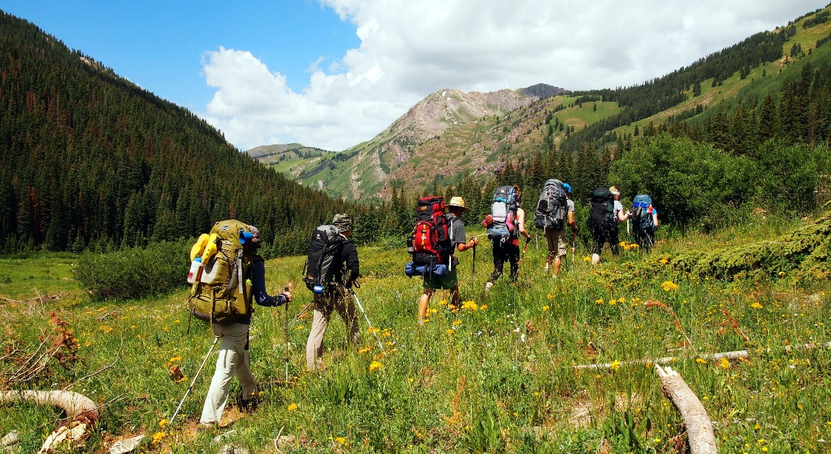
3a. Trek Crew Size
Most wilderness areas have a limit on the number of people allowed in overnight backcountry groups.
  Although the size limits vary, most areas allow groups of no more than 15 people to camp and travel together.
Smaller groups can share equipment efficiently and require less space for camping.
Larger Groups have a bigger impact on the wilderness and wildlife
  Trail Impacts: Hiking in larger groups compounds our footprints. One person crossing a meadow might not do much, but a dozen people in a line will establish a trail.
  Campsite Impacts: When we camp in large groups, we risk trampling the soil/plants. We may end up creating a trail to reach the river from camp, building a larger fire, or going to the bathroom in one general area.
  Scaring Wildlife: Larger groups make more noise and are likely to scare off wildlife. This disturbs the natural habits of animals and (from a selfish perspective) means we won’t get to see these animals in their natural setting.
Groups have a larger impact on other visitors
  We go into wilderness partly to escape the intrusions of other people. Crossing paths with a large group of noisy hikers can detract from the wilderness we came to enjoy.

Slide 52
Requirement 3
Do the following:
  Define limits on the number of backpackers appropriate for a trek crew.
  Describe how a trek crew should be organized.
  Tell how you would minimize risk on a backpacking trek.
  Explain the purpose of an emergency response plan.

Slide 53
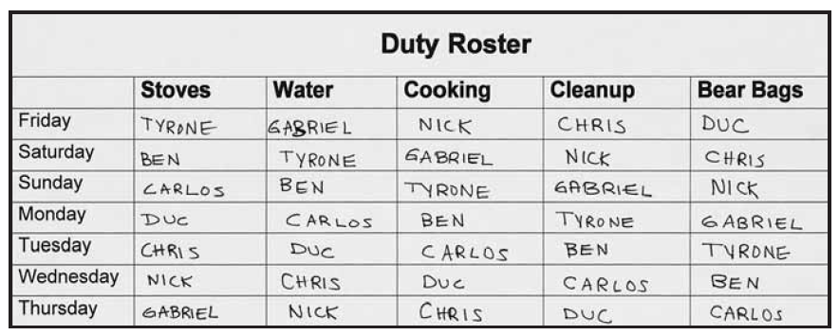
3b. Trek Crew Organization
The patrol method is an effective way to organize a trek.
On the trail, the patrol leader stays aware of how each patrol member is doing and how the entire group is getting along.
He encourages everyone to be involved in finding the route, choosing campsites, and taking part in completing all the tasks to make a backpacking trip the best it can be.
The patrol leader also finds opportunities for others to solve problems, to practice and improve their backcountry skills, and to become effective leaders themselves.
Many backpacking groups use a duty roster so that everyone has an equal chance to cook, clean up after meals, manage bear bags, and take care of other camp tasks.

Slide 54
Requirement 3
Do the following:
  Define limits on the number of backpackers appropriate for a trek crew.
  Describe how a trek crew should be organized.
  Tell how you would minimize risk on a backpacking trek.
  Explain the purpose of an emergency response plan.

Slide 55
3c. Minimizing Risk
A truly effective approach to reducing risk comes from the willingness of every group member to take an active role in maximizing personal safety and the safety of others.
The more responsibility each person takes for his or her own health and safety, the more everyone can contribute to a successful trek.
To help minimize risk, follow these suggestions:
  Stay in good shape so you are ready for the physical demands of a trek.
  Know where you are going and what to expect.
  Adjust clothing layers to match changing conditions.
  Drink plenty of water.
  Take care of gear.
A critical aspect of managing risk is letting others know when you are having difficulties or are aware of a concern that might affect you or the group.
Even if you feel hesitant to speak up, voicing concern about questionable route decisions or changing weather conditions, for example, can bring important matters to the group’s attention.

Slide 56
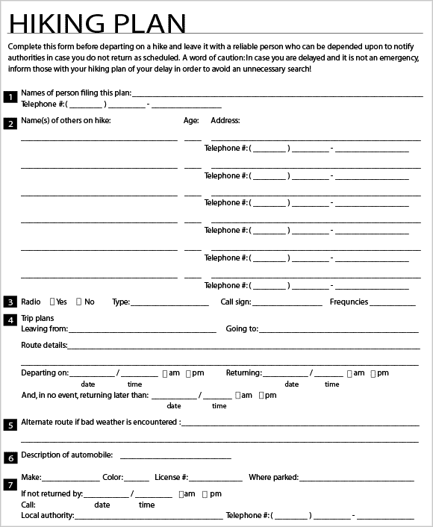
3c. Minimizing Risk
Wherever you decide to go backpacking, you will need to prepare a written trip plan.
Always leave your detailed itinerary with a responsible person.
Write down who to contact and when, if you haven’t returned at your expected time.
Leave a piece of paper with contact information under the front seat of your car, too.
See the Sample Hiking Plan on the right for information to be included.

Slide 57
Requirement 3
Do the following:
  Define limits on the number of backpackers appropriate for a trek crew.
  Describe how a trek crew should be organized.
  Tell how you would minimize risk on a backpacking trek.
  Explain the purpose of an emergency response plan.

Slide 58
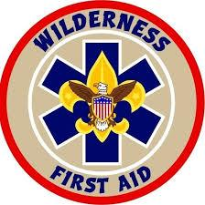
3d. Emergency Response Plan
Dealing With Health Issues and Injuries
  Getting injured while out on the trail is one of the biggest risks for which you need to be prepared.
  Fortunately, soap, water, bandages, and other items in your first-aid kit will take care of the majority of medical problems you may encounter.
  However, the danger of a more serious injury is magnified by your distance from emergency response. Miles up a trail, you must rely on your own resources and those of your companions.
  Know how to prevent, recognize, and treat the health hazards that may arise during a backpacking trip by taking a wilderness first aid course.

Slide 59
Requirement 4
Do the following:
  Describe the importance of using Leave No Trace principles while backpacking, and at least five ways you can lessen the crew’s impact on the environment.
  Describe proper methods of handling human and other wastes while on a backpacking trek. Describe the importance of and means to assure personal cleanliness while on a backpacking trek.
  Tell what factors are important in choosing a campsite.

Slide 60

4a. Leave No Trace
Plan ahead and prepare.
Travel and camp on durable surfaces.
Dispose of waste properly.
Leave what you find.
Minimize campfire impacts.
Respect wildlife.
Be considerate of other visitors.

Slide 61
4a. Leave No Trace
Plan Ahead and Prepare:
  Proper trip planning and preparation helps hikers and campers accomplish trip goals safely and enjoyably while minimizing damage to natural and cultural resources. Campers who plan ahead can avoid unexpected situations, and minimize their impact by complying with area regulations such as observing limitations on group size. Schedule your trek to avoid times of high use. Obtain permits or permission to use the area for your trek.
  Proper planning ensures:
    Low-risk adventures because campers obtained information concerning geography and weather and prepared accordingly
    Properly located campsites because campers allotted enough time to reach their destination
    Appropriate campfires and minimal trash because of careful meal planning and food repackaging and proper equipment
    Comfortable and fun camping and hiking experiences because the outing matches the skill level of the participants

Slide 62
4a. Leave No Trace
Travel and Camp on Durable Surfaces
  Damage to land occurs when visitors trample vegetation or communities of organisms beyond recovery. The resulting barren areas develop into undesirable trails, campsites, and soil erosion.
  Concentrate Activity, or Spread Out?
    In high-use areas, campers should concentrate their activities where vegetation is already absent. Minimize resource damage by using existing trails and selecting designated or existing campsites. Keep campsites small by arranging tents in close proximity.
    In more remote, less-traveled areas, campers should generally spread out. When hiking, take different paths to avoid creating new trails that cause erosion. When camping, disperse tents and cooking activities—and move camp daily to avoid creating permanent-looking campsites. Avoid places where impacts are just beginning to show. Always choose the most durable surfaces available: rock, gravel, sand, compacted soil, dry grasses, or snow.

Slide 63
4a. Leave No Trace
Dispose of Waste Properly (Pack It In, Pack It Out)
  This simple yet effective saying motivates backcountry visitors to take their trash home with them. It makes sense to carry out of the backcountry the extra materials taken there by your group or others. Inspect your campsite for trash or spilled foods. Accept the challenge of packing out all trash, leftover food, and litter.

Slide 64
4a. Leave No Trace
Leave What You Find
  Allow others a sense of discovery, and preserve the past. Leave rocks, plants, animals, archaeological artifacts, and other objects as you find them. Examine but do not touch cultural or historical structures and artifacts. It may be illegal to remove artifacts.
  Minimize Site Alterations
    Do not dig tent trenches or build lean-tos, tables, or chairs. Never hammer nails into trees, hack at trees with hatchets or saws, or damage bark and roots by tying horses to trees for extended periods. Replace surface rocks or twigs that you cleared from the campsite. On high-impact sites, clean the area and dismantle inappropriate user-built facilities such as multiple fire rings and log seats or tables.
    Good campsites are found, not made. Avoid altering a site, digging trenches, or building structures.

Slide 65
4a. Leave No Trace
Minimize Campfire Impacts
  Some people would not think of camping without a campfire. Yet the naturalness of many areas has been degraded by overuse of fires and increasing demand for firewood.
    Lightweight camp stoves make low-impact camping possible by encouraging a shift away from fires. Stoves are fast, eliminate the need for firewood, and make cleanup after meals easier. After dinner, enjoy a candle lantern instead of a fire.
    If you build a fire, the most important consideration is the potential for resource damage. Whenever possible, use an existing campfire ring in a well-placed campsite. Choose not to have a fire in areas where wood is scarce—at higher elevations, in heavily used areas with a limited wood supply, or in desert settings.
    True Leave No Trace fires are small. Use dead and downed wood that can be broken easily by hand. When possible, burn all wood to ash and remove all unburned trash and food from the fire ring. If a site has two or more fire rings, you may dismantle all but one and scatter the materials in the surrounding area. Be certain all wood and campfire debris is cold out.

Slide 66
4a. Leave No Trace
Respect Wildlife
  Quick movements and loud noises are stressful to animals. Considerate campers practice these safety methods:
    Observe wildlife from afar to avoid disturbing them.
    Give animals a wide berth, especially during breeding, nesting, and birthing seasons.
    Store food securely and keep garbage and food scraps away from animals so they will not acquire bad habits. Never feed wildlife. Help keep wildlife wild.
    You are too close if an animal alters its normal activities.

Slide 67
4a. Leave No Trace
Be Considerate of Other Visitors
  Thoughtful campers respect other visitors and protect the quality of their experience.
    Travel and camp in small groups (no more than the group size prescribed by land managers).
    Let nature’s sounds prevail. Keep the noise down and leave radios, tape players, and pets at home.
    Select campsites away from other groups to help preserve their solitude.
    Always travel and camp quietly to avoid disturbing other visitors.
    Make sure the colors of clothing and gear blend with the environment.
    Respect private property and leave gates (open or closed) as found.
  Be considerate of other campers and respect their privacy.

Slide 68
Requirement 4
Do the following:
  Describe the importance of using Leave No Trace principles while backpacking, and at least five ways you can lessen the crew’s impact on the environment.
  Describe proper methods of handling human and other wastes while on a backpacking trek. Describe the importance of and means to assure personal cleanliness while on a backpacking trek.
  Tell what factors are important in choosing a campsite.

Slide 69

4b. Human Wastes
  Sanitation
    Backcountry users create body waste and wastewater that require proper disposal.
    Wastewater. Help prevent contamination of natural water sources: After straining food particles, properly dispose of dishwater by dispersing at least 200 feet (about 80 to 100 strides for a youth) from springs, streams, and lakes. Use biodegradable soap 200 feet or more from any water source.
    Human Waste. Proper human waste disposal helps prevent the spread of disease and exposure to others. Catholes 6 to 8 inches deep in humus and 200 feet from water, trails, and campsites are often the easiest and most practical way to dispose of feces.
    If you are required to pack out solid waste, bring a supply of pack-it-out bags designed for use in wilderness areas. These tear- and puncture-resistant bags contain chemicals designed to neutralize odors.

Slide 70

4b. Cleanliness while Backpacking
Always start a trip with clean utensils, pocketknives, and kitchen gear.
To help prevent the spread of germs, all members of a group should have and use their own water bottles and eating utensils.
Set out a small bottle of alcohol based hand sanitizer to use before handling food or upon returning from a latrine or cathole.
  A small dab rubbed on the hands will kill most harmful germs and then evaporate, leaving hands dry without the need of a towel.

Slide 71
Requirement 4
Do the following:
  Describe the importance of using Leave No Trace principles while backpacking, and at least five ways you can lessen the crew’s impact on the environment.
  Describe proper methods of handling human and other wastes while on a backpacking trek. Describe the importance of and means to assure personal cleanliness while on a backpacking trek.
  Tell what factors are important in choosing a campsite.

Slide 72

4c. Choosing a Campsite
Safety
Don’t pitch a tent under dead trees or limbs that might fall in a storm.
Stay out of gullies that could fill with flash floods.
Find a site away from lone trees, mountaintops, high ridges, and other likely targets of lightning.
Camp some distance from game trails, especially in bear country.
Size
  A site must be large enough for members of your camping party to pitch their tents and cook their meals.
  When hanging food to keep it away from animals, find the trees you need at least 200 feet from where you will be sleeping.
Terrain
  Does the site you have chosen for camp slope gently for good drainage?
  Leaves, pine needles, and other natural cover can keep the ground from becoming muddy.
  An area open to the east and south will catch sunlight early in the day and perhaps be drier than slopes facing north.

Slide 73

4c. Choosing a Campsite
Privacy
  Respect the privacy of others.
  Trees, bushes, and the shape of the terrain can screen your camp from trails and neighboring campsites.
  Keep the noise down when other campers are staying nearby.
Permission
  Check well ahead of time with land managers of public parks, forests, and reserves. They can issue any permits you will need and may suggest how you can make the most of your campouts.
  Get permission from owners before camping on private property.

Slide 74

4c. Camp Layout
Once you arrive at a site, the first order of business is to figure out the best way to settle in while causing little impact on the land.
Set up a dining fly first. That will provide shelter for food and you in case of rain and will give a sense of where you will center most of your camp activities.
Pitch your tents. Use established tent sites whenever possible. In bear country, tents should be 200 feet or more from the cooking area and from areas where food will be stored.
Establish a plan for personal sanitation and be sure everyone understands what he is to do.

Slide 75
Requirement 5
Do the following:
  Demonstrate two ways to treat water and tell why water treatment is essential.
  Explain to your counselor the importance of staying well hydrated during a trek.

Slide 76



5a. Treating Water
Boiling. The surest means of making your water safe is by boiling it. Use a pot or other metal container on a stove or over a fire and bring the water to a full boil.
Chemical Treatment. Water-treatment tablets contain iodine or chlorine to kill waterborne bacteria and viruses. They are effective and easy to use. An emergency survival kit should have a supply of water treatment tablets.
Filtering. Most backcountry filters are simple handheld pumps used to force water through a screen with pores so small that bacteria and protozoa cannot get through. The finer the screen, the more effective the filter. Information provided with new filters describes their use, maintenance, and the degree of filtration they can provide.

Slide 77
Requirement 5
Do the following:
  Demonstrate two ways to treat water and tell why water treatment is essential.
  Explain to your counselor the importance of staying well hydrated during a trek.

Slide 78

5b. Staying Hydrated
Water is essential for nearly every bodily function, including digestion, respiration, brain activity, producing heat, and staying cool.
A person who loses more water than he takes in risks becoming dehydrated.
The first sign of dehydration usually is dark urine.
Other signs can include weariness, headache, body aches, confusion, and dark amber–colored urine.
Heat exhaustion, heatstroke, and hypothermia may all be caused in part by dehydration.
Prevent dehydration and heat reactions by drinking plenty of fluids.
That is easy to do on hot summer days when you are thirsty but it is just as important in cold weather when you may not feel thirsty.
Drink enough so that your urine stays clear.

Slide 79
Requirement 6
Do the following:
  Demonstrate that you can read topographic maps.
  While on a trek, use a map and compass to establish your position on the ground at three different locations, OR use a GPS receiver to establish your position on a topographic map and on the ground at three different locations.
  Explain how to stay found, and what to do if you get lost.

Slide 80

6a. Reading Topographic Maps
Click on the image for a tutorial and video on how to read a topographic map.

Slide 81
Requirement 6
Do the following:
  Demonstrate that you can read topographic maps.
  While on a trek, use a map and compass to establish your position on the ground at three different locations, OR use a GPS receiver to establish your position on a topographic map and on the ground at three different locations.
  Explain how to stay found, and what to do if you get lost.

Slide 82

6b. Using a Map and Compass
Click on the image for a tutorial and video on how to use a compass with a topographic map.

Slide 83

6b. Using GPS
Click on the image for a tutorial and video on how to choose and use a GPS receiver.

Slide 84
Requirement 6
Do the following:
  Demonstrate that you can read topographic maps.
  While on a trek, use a map and compass to establish your position on the ground at three different locations, OR use a GPS receiver to establish your position on a topographic map and on the ground at three different locations.
  Explain how to stay found, and what to do if you get lost.

Slide 85

6c. How to Stay Found
Maps, compasses, and GPS receivers will be of little help if you don’t remember to use them.
One of the secrets of safe backcountry hiking is the use of thumbnail navigation.
This technique calls for your constant awareness of your position.
You must carry a topographic map where you can easily refer to it, that is, in your shirt or pants pocket rather than in your pack.
As you hike, you should continuously try to match up features around you with points on your map.
  Mark the points you identify on your map.
  Not only will this prevent you from getting too far off your route if you take a wrong turn, it will keep your map-reading skills sharp.
With a basic knowledge of route finding and the use of thumbnail navigation, there is little chance of becoming truly lost.

Slide 86

6c. What to Do if Lost
If you think you are lost, don’t panic and stay put.
When you are late returning to your camp or your home, the persons with whom you left a trip plan will initiate a search for you.
In the meantime, make yourself and your companions comfortable.
Erect your tent or build a small shelter. If your shelter doesn’t provide enough protection to keep you warm, build a small campfire.
If you have a whistle, a distress signal consisting of three short blasts at intervals of about a minute can help a search party find you.
Above all, be patient.

Slide 87
Requirement 7
Tell how to prepare properly for and deal with inclement weather.

Slide 88

7. Preparing for Inclement Weather
Changing weather conditions is a common risk encountered by backpackers.
To avoid getting caught in a storm, keep your eye on the sky.
Changes in the clouds, the temperature, and the direction of the wind can all signal an approaching storm.
By anticipating bad weather, you will have time to pull on your rain gear or perhaps even to reach a campsite and put up your tent.
Watch out for everyone in your crew. If some members of your crew are having a hard time coping with the weather, help them get sheltered, dry, and comfortable.

Slide 89

7. Staying Safe During a Thunderstorm
When hiking near mountaintops get downhill before the lightning begins, if possible and take cover at lower elevations and in groves of trees.
If a storm catches you, take shelter in a cave or a low spot among the rocks, making sure to avoid prominent outcroppings and overhangs.
If you cannot find shelter, become the smallest target you can.
  Squat on the balls of your feet, cover your ears with your hands, and get your head close to your knees.

Slide 90
Requirement 8
Do the following:
  Explain the advantages and disadvantages of the different types of backpacking stoves using at least three different types of fuel.
  Demonstrate that you know how to operate a backpacking stove safely and to handle liquid fuel safely.
  Prepare at least three meals using a stove and fuel you can carry in a backpack.
  Demonstrate that you know how to keep cooking and eating gear clean and sanitary , and that you practice proper methods for food storage while on a backpacking trek.

Slide 91


8a. Selecting a Stove
Selecting a Stove
  The stove you choose depends upon the kind of cooking you will do, the type of fuel you wish to use, and the amount of weight you are willing to carry.
  Always read and follow the manufacturer’s instructions for carrying, fueling, using, and storing camp stoves.
Canister Stove
Liquid Fuel Stove

Slide 92

8a. Canister vs. Liquid Fuel Stoves
Stove Weight
  Canister stoves are the clear winner in this category – they’re almost always lighter and more compact than their liquid fuel counterparts.
Fuel Weight
  A single fuel canister weighs less than a liquid fuel bottle, but a bunch of canisters can add up to significantly more weight than a liquid fuel bottle. Remember, you’ll have to carry canisters for the remainder of your trip – even after they’re spent.
  On a short trip that only requires a little cooking, the canister is king.
  If you’re on a long trip or planning to run the stove a lot, carrying a large bottle of liquid fuel is the best way to go.

Slide 93

8a. Canister vs. Liquid Fuel Stoves
Temperature
  In most cases, liquid fuel stoves offer the best performance in cold conditions.
  Cold temperatures create low canister pressure, rendering most canister stoves useless in really cold conditions.
Environmental Impact
  Liquid fuels require less energy input and offer a more environmentally friendly way to cook in the outdoors. The key is the reusable fuel bottle.
  Spent fuel canisters can be recycled as mixed metal (not aluminum) but not that many recycling programs take these metals, and even fewer recognize the canisters and process them.

Slide 94


8a. Canister vs. Liquid Fuel Stoves
Economy
  In most cases, canister stoves cost less than liquid fuel stoves.
  At the same time, canister fuel often costs considerably more than liquid fuel.
Maintenance
  Canister stoves require practically zero maintenance to run reliably for decades.
  Liquid stoves are famous for their reliability, but require more maintenance.
  Luckily, the stoves are easy to work on and the cleaning process is simple.
Fuel Availability
  Canister fuel is available in a wide range of places, but not everywhere.
  If you’re planning on traveling in countries and regions well off the beaten path, liquid fuel is a safer bet.

Slide 95
Requirement 8
Do the following:
  Explain the advantages and disadvantages of the different types of backpacking stoves using at least three different types of fuel.
  Demonstrate that you know how to operate a backpacking stove safely and to handle liquid fuel safely.
  Prepare at least three meals using a stove and fuel you can carry in a backpack.
  Demonstrate that you know how to keep cooking and eating gear clean and sanitary , and that you practice proper methods for food storage while on a backpacking trek.

Slide 96

8b. Using Stoves Safely
Before lighting any stove, read the manufacturer’s instructions and follow the instructions exactly.
Always heed these stove safety rules:
  Never use a stove inside or near a tent.
  Don’t overload a stove with a heavy pot. Instead, set up a grill over the stove to bear the weight of the pot.
  Never leave a burning stove unattended.
  Let a stove cool completely before you put it away.
  For long-term storage, empty the fuel tank.
  Do not open the fuel cap of a hot stove or attempt to refuel a hot stove.
  Store liquid fuel only in well-marked metal fuel bottles designed specifically for that use.
  Keep fuel bottles and canisters away from sources of heat.
  Do not store fuel containers inside your house.

Slide 97
Requirement 8
Do the following:
  Explain the advantages and disadvantages of the different types of backpacking stoves using at least three different types of fuel.
  Demonstrate that you know how to operate a backpacking stove safely and to handle liquid fuel safely.
  Prepare at least three meals using a stove and fuel you can carry in a backpack.
  Demonstrate that you know how to keep cooking and eating gear clean and sanitary, and that you practice proper methods for food storage while on a backpacking trek.

Slide 98



8c. Backpacking Meals
Click on the following link to find these and many other Backpacking Recipes

Slide 99
Requirement 8
Do the following:
  Explain the advantages and disadvantages of the different types of backpacking stoves using at least three different types of fuel.
  Demonstrate that you know how to operate a backpacking stove safely and to handle liquid fuel safely.
  Prepare at least three meals using a stove and fuel you can carry in a backpack.
  Demonstrate that you know how to keep cooking and eating gear clean and sanitary, and that you practice proper methods for food storage while on a backpacking trek.

Slide 100

8d. Cleaning Up After Meals
To keep cooking and eating gear clean and sanitary, set up a dishwashing system.
  Scrape any remaining food from all dishes into the trash that you will be packing out.
  Fill a wash pot with hot water and add a few drops of biodegradable soap.
  Wash pots and utensils and rinse them in a pot of cold water that contains a few drops of bleach or a sanitizing tablet and then in a pot of clear hot water.
  Allow clean dishes and pots to air dry.
Strain the wash water into a single pot using mesh or a bandana to capture food residue.
Dump the food residue into the trash that you’re planning to pack out.
Get rid of the wash water by digging a sump hole (6-8” deep hole) and straining the water into the hole or broadcast it around in multiple directions to ensure the liquid is spread over a wide area.

Slide 101


8d. Food Storage
Store your food where it will be safe from animals and bad weather.
In the backcountry, and anywhere that bears may be present, a bear canister is often the answer.
Where permitted and if trees are available, hanging a bear bag is another option.

Slide 102


8d. Food Storage
Additional Bear Bagging Techniques

Slide 103
Requirement 9
Do the following:
  Write a plan that includes a schedule for a patrol/crew backpacking hike of at least 2 miles.
  Conduct a prehike inspection of the patrol and its equipment.
  Show that you know how to properly pack your personal gear and your share of the crew’s gear and food.
  Show you can properly shoulder your pack and adjust it for proper wear.
  While using the plan you developed for requirement 9a, carry your fully loaded pack to complete a hike of at least 2 miles.

Slide 104

9a. Shakedown Hike Preparation
Shakedown hikes and backpacking trips are the best way you can train yourself to become a confident backpacker or day hiker.
They provide a low pressure setting for you to practice new skills, learn how to use your gear, plan a hike, and develop the physical fitness required to hike all day with a backpack.
Download the Hiking Trip Plan and complete it for a patrol/crew backpacking hike of at least 2 miles.

Slide 105
Requirement 9
Do the following:
  Write a plan that includes a schedule for a patrol/crew backpacking hike of at least 2 miles.
  Conduct a prehike inspection of the patrol and its equipment.
  Show that you know how to properly pack your personal gear and your share of the crew’s gear and food.
  Show you can properly shoulder your pack and adjust it for proper wear.
  While using the plan you developed for requirement 9a, carry your fully loaded pack to complete a hike of at least 2 miles.

Slide 106

9b. Prehike Inspection
A day or two before you depart on a backpacking trip, spread out all the equipment, clothing, and provisions you and your crew intend to take.
Consider each item carefully and set aside any that are not absolutely necessary.
  Some items may make your trip more pleasant, but decide whether they are worth the extra weight.
Figure out how you will divide up the food and group equipment you will be taking.
  Everyone should share the responsibility of carrying the group’s equipment.
Check off each item on your list of food and gear, and be sure you have all the essentials.
After your hike, reevaluate what you really need and what you can leave at home next time.
By eliminating ounces wherever you can, you will shave pounds off the weight on your back.

Slide 107
Requirement 9
Do the following:
  Write a plan that includes a schedule for a patrol/crew backpacking hike of at least 2 miles.
  Conduct a prehike inspection of the patrol and its equipment.
  Show that you know how to properly pack your personal gear and your share of the crew’s gear and food.
  Show you can properly shoulder your pack and adjust it for proper wear.
  While using the plan you developed for requirement 9a, carry your fully loaded pack to complete a hike of at least 2 miles.

Slide 108

9c. Packing Your Backpack
Click on the following link for a tutorial on packing your backpack:
How to Pack a Backpack the Right Way

Slide 109
Requirement 9
Do the following:
  Write a plan that includes a schedule for a patrol/crew backpacking hike of at least 2 miles.
  Conduct a prehike inspection of the patrol and its equipment.
  Show that you know how to properly pack your personal gear and your share of the crew’s gear and food.
  Show you can properly shoulder your pack and adjust it for proper wear.
  While using the plan you developed for requirement 9a, carry your fully loaded pack to complete a hike of at least 2 miles.

Slide 110

9d. Hoisting and Adjusting Your Pack
Click on the image for a video on hoisting your backpack:
Click on the following link for a tutorial on fitting and adjusting your backpack:
Backpacks: Fit & Torso Size Guide

Slide 111
Requirement 9
Do the following:
  Write a plan that includes a schedule for a patrol/crew backpacking hike of at least 2 miles.
  Conduct a prehike inspection of the patrol and its equipment.
  Show that you know how to properly pack your personal gear and your share of the crew’s gear and food.
  Show you can properly shoulder your pack and adjust it for proper wear.
  While using the plan you developed for requirement 9a, carry your fully loaded pack to complete a hike of at least 2 miles.

Slide 112
9d. Shakedown Hike
  While using the plan you developed for requirement 9a, carry your fully loaded pack to complete a hike of at least 2 miles.

Slide 113
Requirement 10
Using Leave No Trace principles, participate in at least three backpacking treks of at least three days each and at least 15 miles each, and using at least two different campsites on each trek. Carry everything you will need throughout the trek.

Slide 114
10. Three Backpacking Treks

Slide 115
Requirement 11
Do the following:
  Write a plan for a backpacking trek of at least five days using at least three different campsites and covering at least 30 miles. Your plan must include a description of and route to the trek area, a schedule (including a daily schedule), a list of food and equipment needs, a safety and emergency plan, and a budget.
  Using Leave No Trace principles, take the trek as planned in requirement 11a that is at least five full days, covering at least 30 miles and utilizing at least three different campsites. While on trek, complete at least one service project approved by your merit badge counselor.
  Keep a daily journal during the trek that includes a day-by-day description of your activities, including notes about what worked well and thoughts about improvements that could be made for the next trek.

Slide 116

11a. Backpacking Trek Plan
Use the form in the Backpacking Merit Badge Workbook to complete this requirement.

Slide 117
Requirement 11
Do the following:
  Write a plan for a backpacking trek of at least five days using at least three different campsites and covering at least 30 miles. Your plan must include a description of and route to the trek area, a schedule (including a daily schedule), a list of food and equipment needs, a safety and emergency plan, and a budget.
  Using Leave No Trace principles, take the trek as planned in requirement 11a that is at least five full days, covering at least 30 miles and utilizing at least three different campsites. While on trek, complete at least one service project approved by your merit badge counselor.
  Keep a daily journal during the trek that includes a day-by-day description of your activities, including notes about what worked well and thoughts about improvements that could be made for the next trek.

Slide 118

11b. Service Project
Aside from your commitment to Leave No Trace, find out what else you can do to help preserve the wilderness. Contact land managers and conservation organizations. Your crew might help repair or maintain existing trails, build a new trail, clean water bars and other drainage structures, or clear fallen logs from backcountry routes.
When you arrange to work on a service project, find out from land managers what tools or equipment you will need. You may be able to trek to a work site where equipment is already in place. Camping near and taking part for several days in a backcountry conservation project will involve hard work, but it will be tremendously rewarding.
Including service projects as a regular part of your outdoor adventures can lead to a long-term partnership with land managers. As they become acquainted with you and learn of your commitment and skills, they are likely to put more effort into matching your group with interesting projects that will allow you to make a real difference.

Slide 119
Requirement 11
Do the following:
  Write a plan for a backpacking trek of at least five days using at least three different campsites and covering at least 30 miles. Your plan must include a description of and route to the trek area, a schedule (including a daily schedule), a list of food and equipment needs, a safety and emergency plan, and a budget.
  Using Leave No Trace principles, take the trek as planned in requirement 11a that is at least five full days, covering at least 30 miles and utilizing at least three different campsites. While on trek, complete at least one service project approved by your merit badge counselor.
  Keep a daily journal during the trek that includes a day-by-day description of your activities, including notes about what worked well and thoughts about improvements that could be made for the next trek.

Slide 120




11c. Trek Journal
A good way to document the highlights of your backcountry trip is to keep a trek journal or logbook. As your trek journal fills over the years, you will have a valuable record of your backpacking adventures. Use a spiral notebook, composition book, or a “Rite-in-the-Rain” notebook.
Include a description of your route and a list of your companions. Write a paragraph or two each day about the highlights of that day’s adventure. Note when things went particularly well, and when things didn’t go quite as planned. Include your thoughts on how you might avoid similar mishaps the next time.

